Slide 1
Presentation Overview
Project Overview
2. Previously Completed Phases
Phase 1 – Channel rehabilitation (Rge Rd 264 to D/S of 263)
Phase 2 –Bridge culvert replacements (Rge Rd 263 to 262)
Phase 3 –Villeneuve hamlet drainage rehabilitation
3. Future Planned Work
Phase 4 – Channel rehabilitation (2025, Hwy 44 to Rge Rd 264)
Focus area for today’s discussion: Area adjacent to St. Peter's Cemetery
4. Questions

Slide 2
Villeneuve Drainage – Project Overview
Project Goals
Mitigate historical flooding concerns in the Villeneuve area
Rehabilitate existing drainage channel to improve flow
Replace and upgrade existing bridge culverts which are at end of life to improve flow and ensure continued road network operations
Project Area
Hwy 44 / Villeneuve hamlet to the Sturgeon River (just east of Rge Rd 262)
Project Chronology
2018 - Initial planning began with high level assessments of the area and drainage concerns
2022/23 - Phase 1, channel rehabilitation from Rge Rd 264 to downstream of Rge Rd 263
2022 - Phase 2, bridge culvert replacements between Rge Rd 263 and 262
2023/24 - Phase 3, Villeneuve hamlet drainage rehabilitation
2025 (Planned), Phase 4, channel rehabilitation between Hwy 44/Villeneuve hamlet and Rge Rd 264

Slide 3
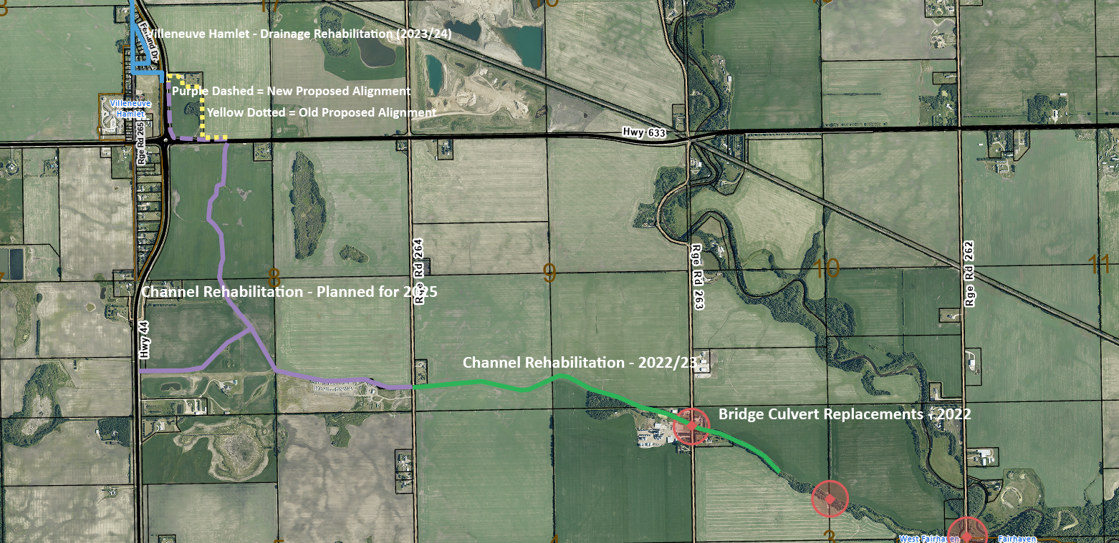
Villeneuve Drainage Project – All Phases
2025

Slide 4
Villeneuve Drainage – Phase 4 (2025)
Project Phase Scope
Rehabilitation of the following channel segments:
Area NE of Hwy 633/44 intersection (Portion of channel adjacent to St. Peter’s Cemetery)
Connects Villeneuve hamlet to Villeneuve drainage channel
Area SE of Hwy 633/44 (Portion of channel between Hwy 44/633 and Rge Rd 264)
Connects hamlet area to the existing improved channel downstream of Rge Rd 264
Project Phase Considerations
Alberta Transportation and Economic Corridors project feedback
Landowner feedback
Historical drainage channel routing

Slide 5
Villeneuve Drainage Project – Phase 4 (2025 – Purple)

Slide 6
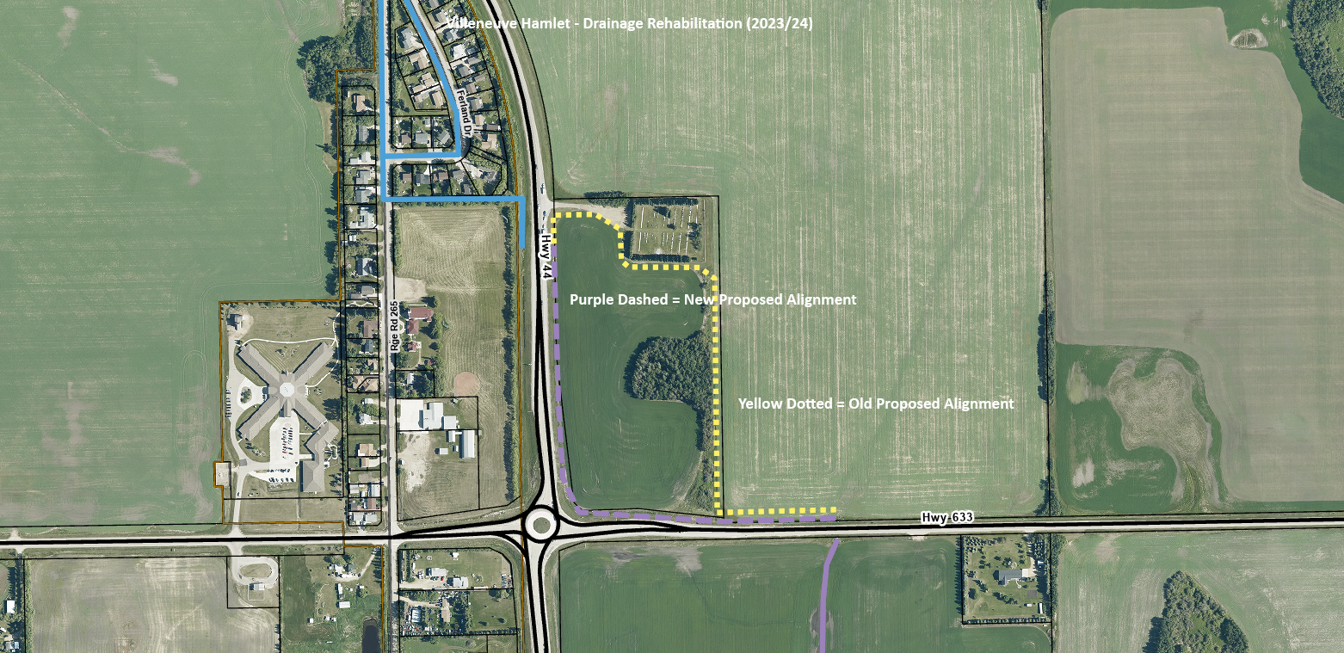
Villeneuve Drainage Project – Phase 4 Focus Area (2025 – White Circled)
Area of Focus

Slide 7
Villeneuve Drainage – Phase 4 (2025)
Resident Feedback
Sturgeon County heard residents' opposition to the previously proposed (yellow dotted) channel alignment
Concerns centred around the proximity to the St. Peter’s Cemetery, and the significance of this place for the community
County Response
Sturgeon County has re-engaged Alberta Transportation and Economic Corridors, and received a positive initial response to constructing the channel in the current ditch alignment (purple dashed line)
This will provide much greater separation from the St. Peter’s Cemetery by following the existing ditch alignment
Status
Land acquisition complete SE of Hwy 633 and 44, detailed design underway
Preliminary design underway for new channel alignment, NE of Hwy 633 and 44

Slide 8
Villeneuve Drainage – Phase 4 (2025)
Next Steps
Completion of design for all channel segments, including new alignment NE of 633/44
Provincial approvals (environmental, highways)
Tendering and construction (2025)

