Slide 1
Starkey Road Pathway and Pedestrian Bridge
January 29, 2025 - Open House

Slide 2
Welcome & Agenda
Purpose of open house and survey:
Provide information about the project and keep residents informed.
Gather resident feedback for consideration on the bridge design in advance of the 2025 construction program.
Presentation
Q&A opportunity
Explore information boards, one-on-one discussions
Complete project survey tonight
Or complete the online survey at home

Slide 3
Partnering with the community
Keeping residents informed
Informing and connecting with residents about project timeline and impact to their community
Listening to local voices
Gathering local perspectives
Using feedback to enhance our projects
Considering public feedback in our final designs where possible

Slide 4
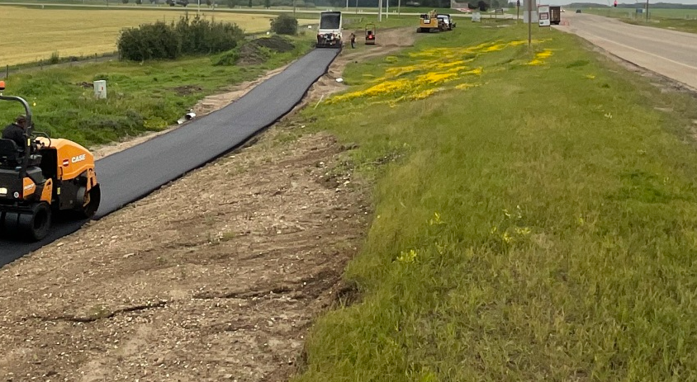
Pedestrian Bridge and Pathway Project
Project description: To build a dedicated pedestrian/cycling pathway and crossing over the Sturgeon River.
Key benefits: Enhancing safety and connectivity gaps for active transportation in the developed areas of the Sturgeon Valley to create a thriving community.
Construction budget: $4.48 million, including a $1.74 million Infrastructure Canada Active Transportation Grant
Timeline: Scheduled for the 2025 construction season
Work includes:
Early work to prepare the area
Drainage/access improvements
Bridge design, fabrication and delivery
Pathway construction
Bridge site construction and installation

Slide 5
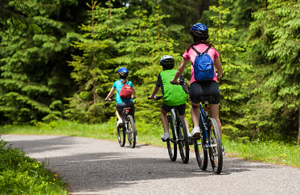
Active Transportation System
Active transportation = using your own power to get from one place to another
Vision
"The Sturgeon Valley Trails System is one that is designed to create a safe and connected network of trails for all ages in all seasons”
– The Path Forward Report, 2021
System principles:
Cohesion
Directness
Accessibility
Alternatives
Safety and security
Comfort
Notes:
This includes:
walking
biking
skateboarding
in-line skating/rollerblading
jogging and running
non-mechanized wheel chairing
snowshoeing and cross-country skiing
Active transportation benefits our:
health
society
transportation system
environment
economy
This is because active transportation:
gives us an opportunity to be physically active on a regular basis
is accessible to Canadians and increases social exchanges
reduces road congestion
contributes to reducing greenhouse gas emissions
saves money on gas and parking
A connected, comfortable, and maintained active transportation network is an essential element to encourage people to walk, bike, or use modes other than a vehicle for transportation and recreation.
Connectivity Assessment phase included a deeper analysis of the places
that people wanted to go and identify the barriers or gaps to them doing so.
This resulted in the Proposed Active Transportation Network as shown in this report.
Cohesion: The network is connected in terms of density of destinations and
routes.
» Directness: The network provides direct and convenient access to
destinations.
» Accessibility: The network accommodates travel for all users, regardless of
ages, income level, or ability.
» Alternatives: There are different route choices available within the
network.
» Safety and Security: Routes in the network minimize the risk of injury,
danger, and crime.
» Comfort: The network appeals to a broad range of age and ability levels,
and consideration is given to user amenities

Slide 6
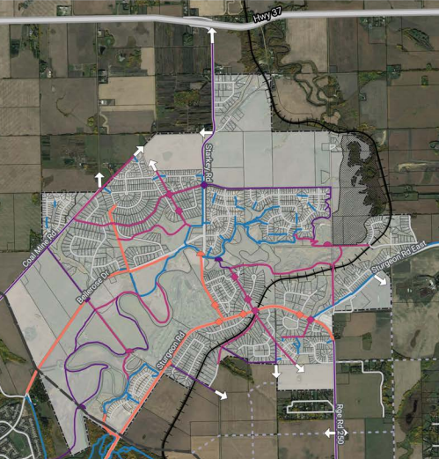
Active Transportation System
Study identified three levels of priority:
High priority trails and routes should be implemented first
Medium priority
Low priority trails and routes can be implemented last, or as development in the area occurs
Notes:
prioritizes creating safer pathways for active transportation along high-traffic and high-speed roads in developed areas based on the vision and principles we described earlier.
This pathway is part of a broader plan to enhance connectivity within the Valley over the coming years, focusing on closing existing gaps while minimizing the creation of new ones. After thorough evaluation, the proposed pathway and bridge location were identified as the most effective solution, offering a cost-efficient approach, requiring minimal land acquisition, improving connections to existing and future trail systems, and enhancing safety for residents.

Slide 7
Pathway and bridge alignment
This is the highest priority route and addresses:
safety along high-volume and high-speed roads
at least one north-south connection across the Sturgeon River
a “quick win”
access for residents to the key travel destination of Bellerose Park
minimal land acquisition requirements
Notes:
safety - by making active transportation safer along high-volume and high-speed roads
having at least one north-south connection across the Sturgeon River
a “quick win” by closing short missing links to connect trails together and neighbourhoods to the existing trail system where there are few current additional considerations (grades, landscaping, etc.)
Addresses key origin/destination travel identified by the residents
Minimal land acquisition requirements

Slide 8
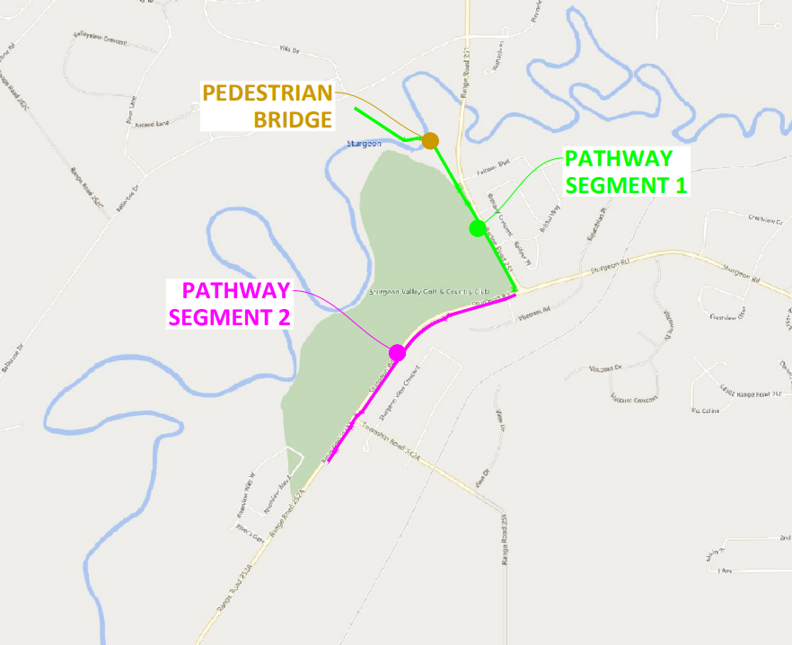
Location map - Alignment

Slide 9
Project funding and budget
Segment 1: Starkey Rd pathway and bridge funding source (2022-2024) | Amount
Sturgeon County (over 3 years) | $2,740,000
Government of Canada Active Transportation Fund Grant | $1,740,000
Total Budget | $4,480,000
Segment 2: (2025 Capital Plan) | Amount
Sturgeon County | $1,140,000
Notes:
Stephen

Slide 10
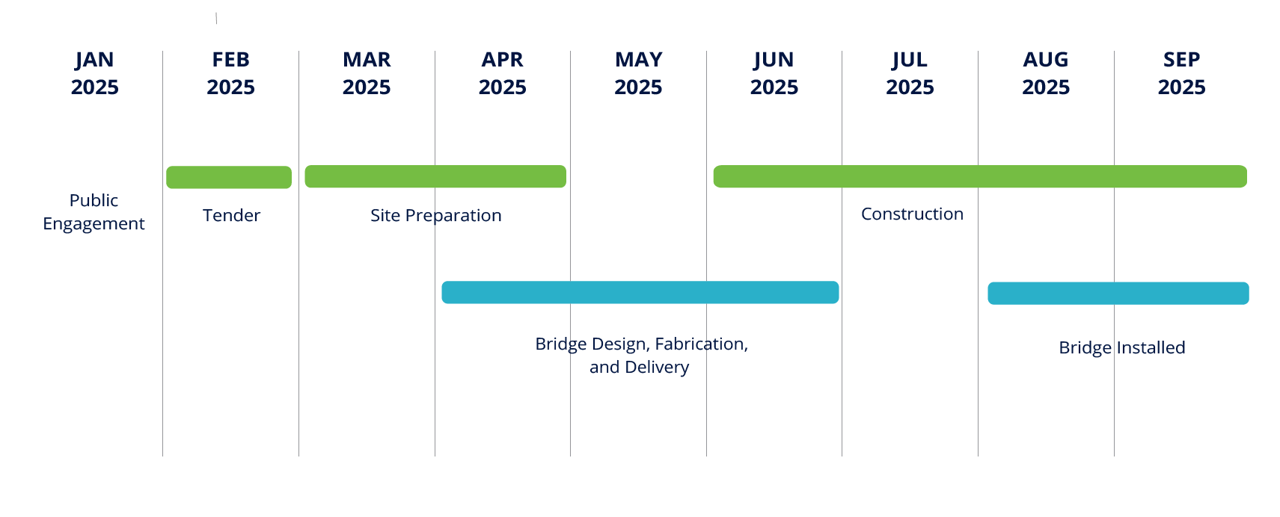
Project timeline
Notes:
stephen

Slide 11
Resident feedback and impacts
Purpose of feedback: To help inform the design, consistent with Sturgeon County Strategic Priorities to "cultivate safe, beautiful and complete communities." This feedback is gathered through the Open House and online survey.
Resident impacts: Traffic interruptions, trail closures (in park), noise and dust during construction.
Project team: Stephen Hinton, Engineering, 780-939-1320
Karolina Drabik, Open Spaces, 780-939-8340

Slide 12
Questions?
Thank you!

